Slide 1

What’s new with ABP 7.0 RC?
Halil İbrahim Kalkan

Slide 2

Overall
Upgraded to .NET 7.0
Upgraded to OpenIddict 4.0
Dapr integration
Integration services
Dynamic features & permissions
External localization system
Distributed entity cache service
Layout hooks for the Blazor UI
Improvements on the eShopOnAbp project

Slide 3
Dapr Integration
Service invocation with C# API Client Proxies integration
Publish & Subscribe with Distributed Event Bus integration
Distributed Lock
Already documented: abp.io/dapr (shortened URL)

Slide 4
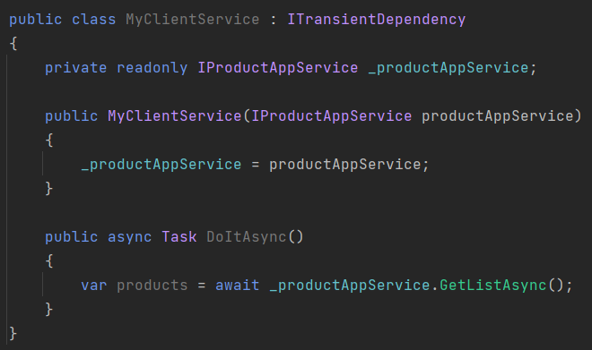
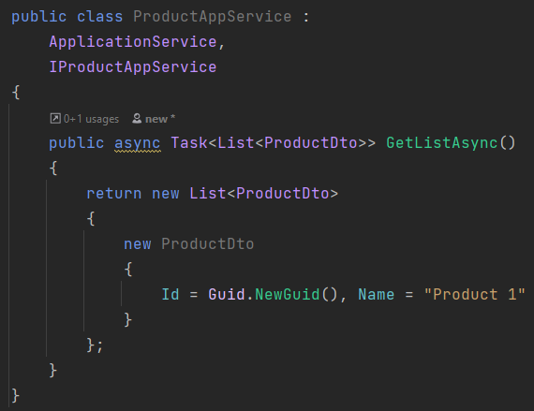
ABP Dynamic C# Client Proxies
.NET Client Application
Server Application
ABP Framework Authentication JSON serialization Exception handling Multi-tenancy
Retry, …. and more

Slide 5
ABP Dynamic C# Client Proxies
.NET Client Application
Server Application
Dapr Sidecar
Dapr Sidecar
ABP Framework Authentication JSON serialization Exception handling Multi-tenancy
Retry, …. and more
Dapr Service discovery Tracing / observability Security
Retry, …. and more

Slide 6

Distributed Event Bus
Microservice A
Microservice B
event
event
ABP Event Bus
Message Broker
(RabbitMQ, Kafka, etc)
ABP Event Bus
application data
application data
re-connect
re-try
publish/subscribe
background workers
auto-events
distributed locking
outbox/inbox
outbox/inbox

Slide 7
Distributed Event Bus
Microservice A
Microservice B
event
event
Dapr Sidecar
Message Broker
(RabbitMQ, Kafka, etc)
Dapr Sidecar
application data
ABP Event Bus
ABP Event Bus
application data
outbox/inbox
outbox/inbox

Slide 8
Integration Services
API Gateway
Product Service
HTTP Requests (external)
UI Application
HTTP Requests (internal)
HTTP Requests (external)
Stock Service
HTTP Requests (external)
3rd-party Clients
HTTP Requests (internal)
HTTP Requests (external)
Ordering Service
HTTP Requests (external)

Slide 9
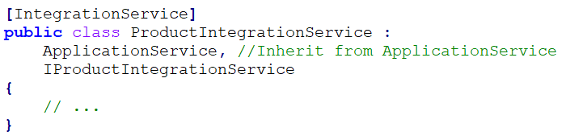
Integration services: How it works?
Introduced the [IntegrationService] attribute
Default HTTP API URL prefix: /integration-api/… instead of /api/…
Audit logging is disabled by default, but can be enabled
Unit of work, Validation, etc. works as expected

Slide 10
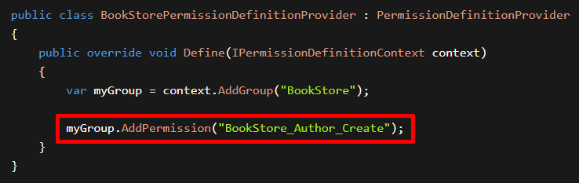
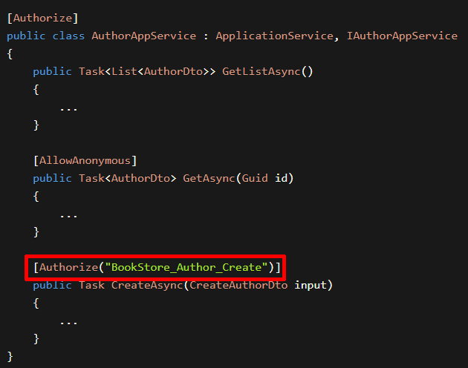
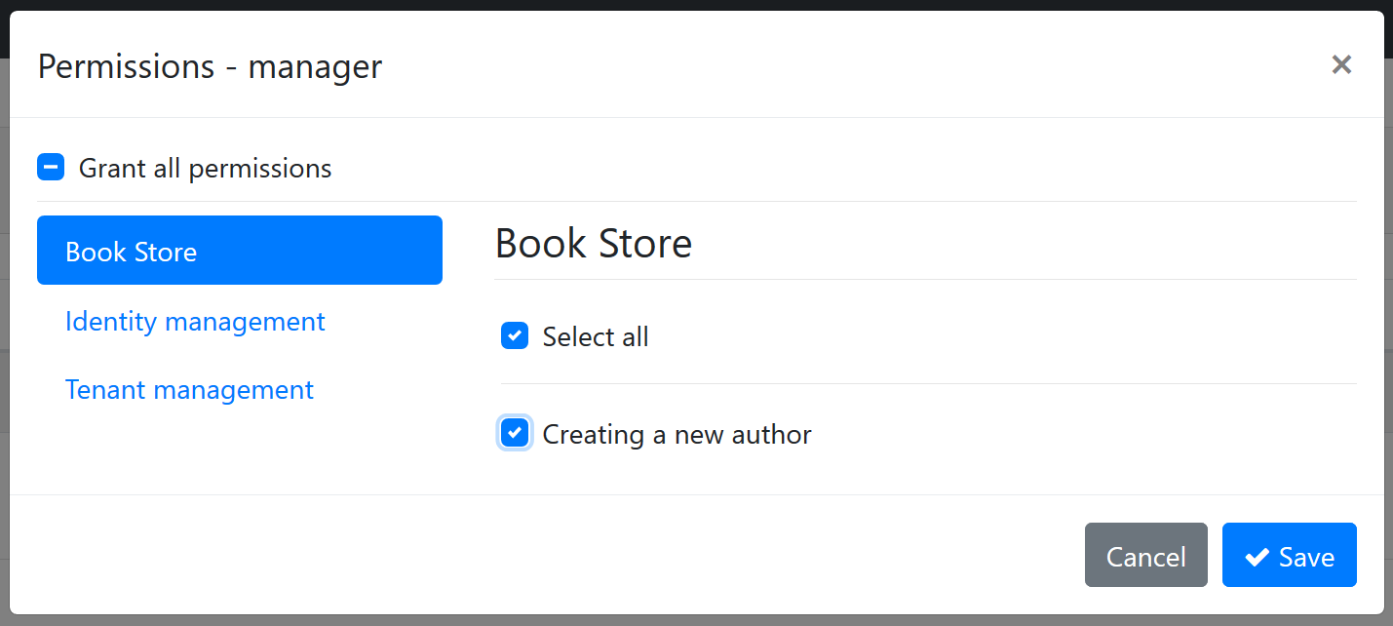
Dynamic Permissions & Features
(1) Define Permissions
(2) Check Permissions
(3) Grant Permissions

Slide 11
Dynamic Permissions & Features
Microservice 1
Permission A, B
Permission Management Database
Microservice 2
Permission C, D, E
The Permission Management UI
Permission Management Microservice
Database Tables AbpPermissionGrants
AbpPermissionGroups AbpPermissions

Slide 12
External Localization System
Auto-sync localization resources defined in all microservices to a shared localization database.
Allow to get and manage localization texts from a single localization service
Introduced the IExternalLocalizationStore service
Optimized localization texts when consumed from clients
Added new APIs to support non-static localization resources

Slide 13
Localization Endpoint Optimization
ABP 6.0: 88.4 kB
ABP 7.0: 42.9 KB (51.4% shorter!)
ApplicationLocalizationScript endpoint can be cached at CDN

Slide 14
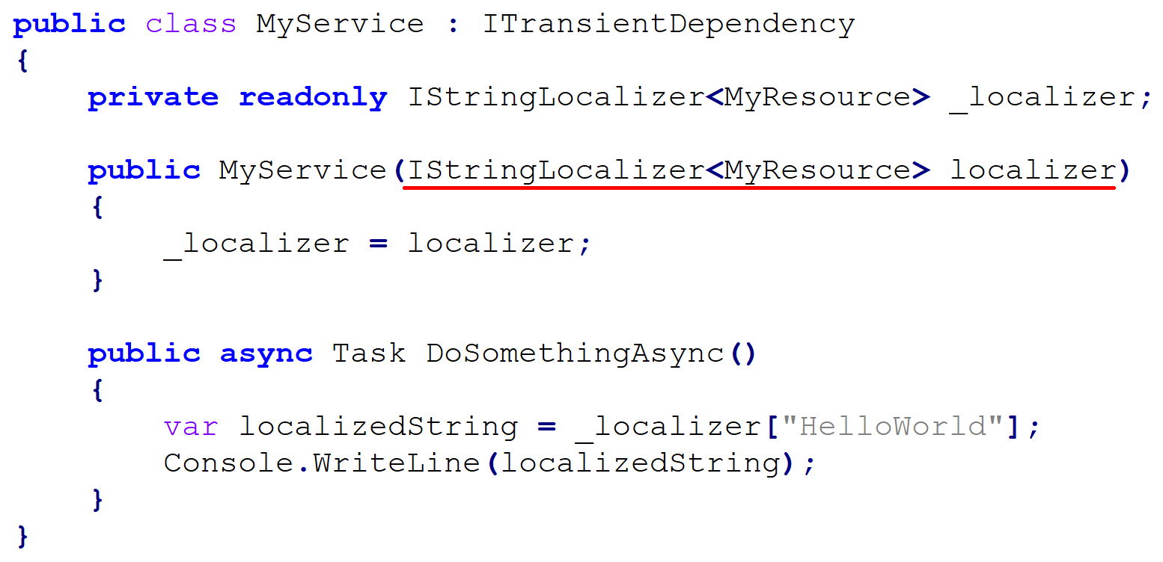
Typed Localization Resources

Slide 15
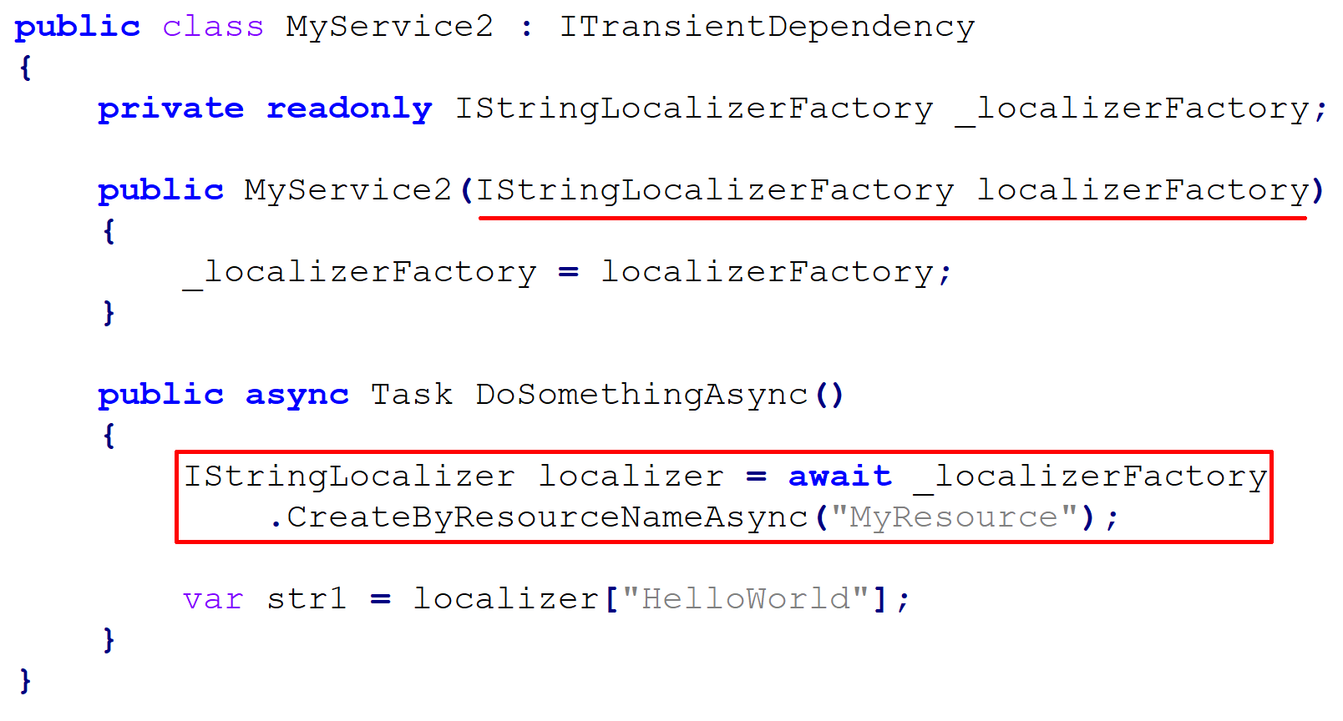
Non-Typed Localization Resources

Slide 16
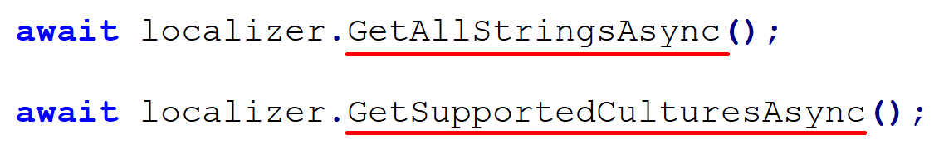
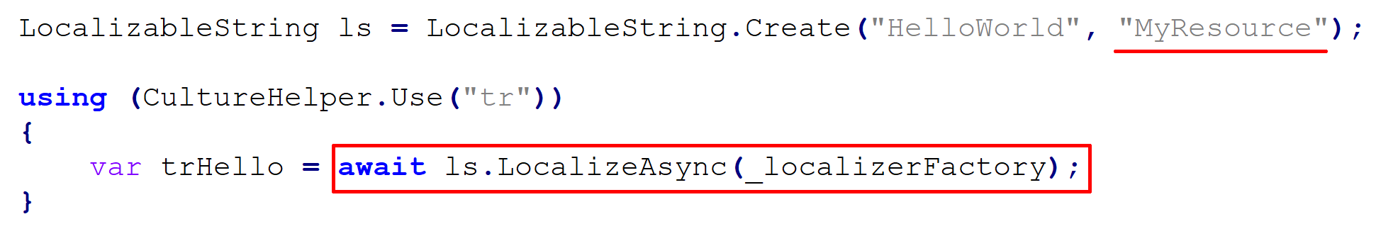
New IStringLocalizer APIs

Slide 17
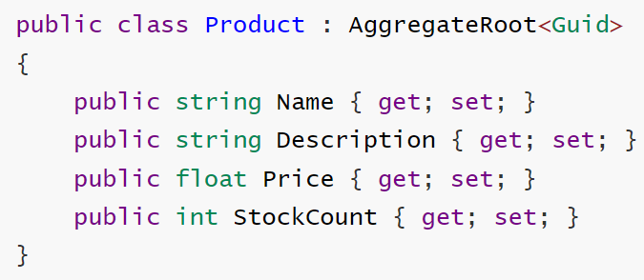
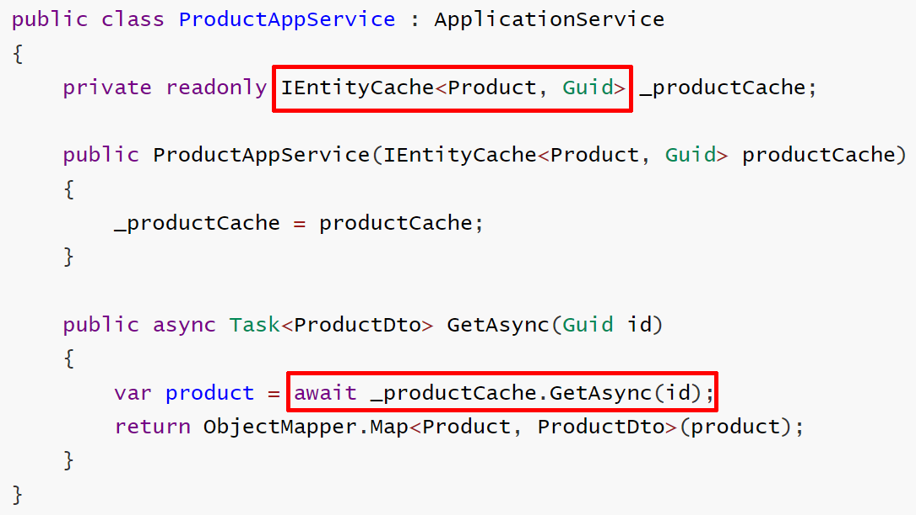
Entity Cache Service
///// you have an entity /////
///// use the cache service /////
///// configure the cache /////

Slide 18
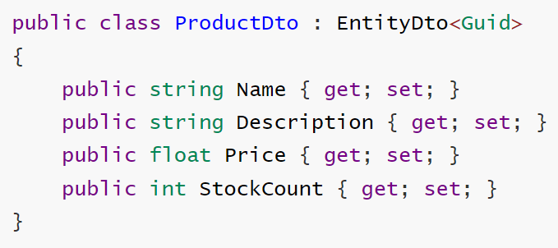
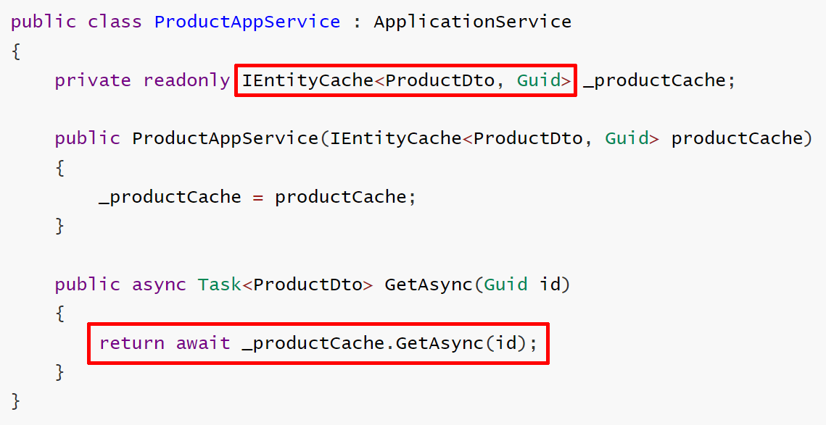
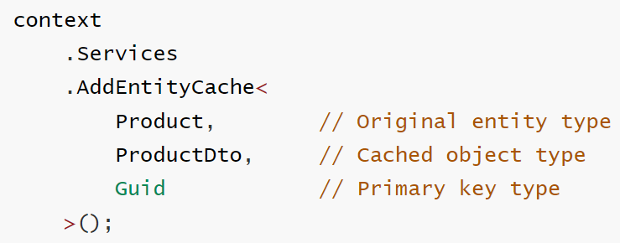
Entity Cache Service
///// you have a DTO class /////
///// use the cache service /////
///// configure the cache /////

Slide 19
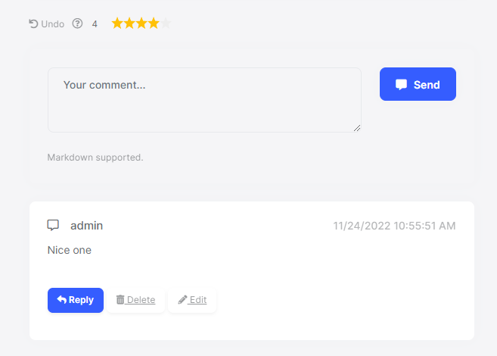
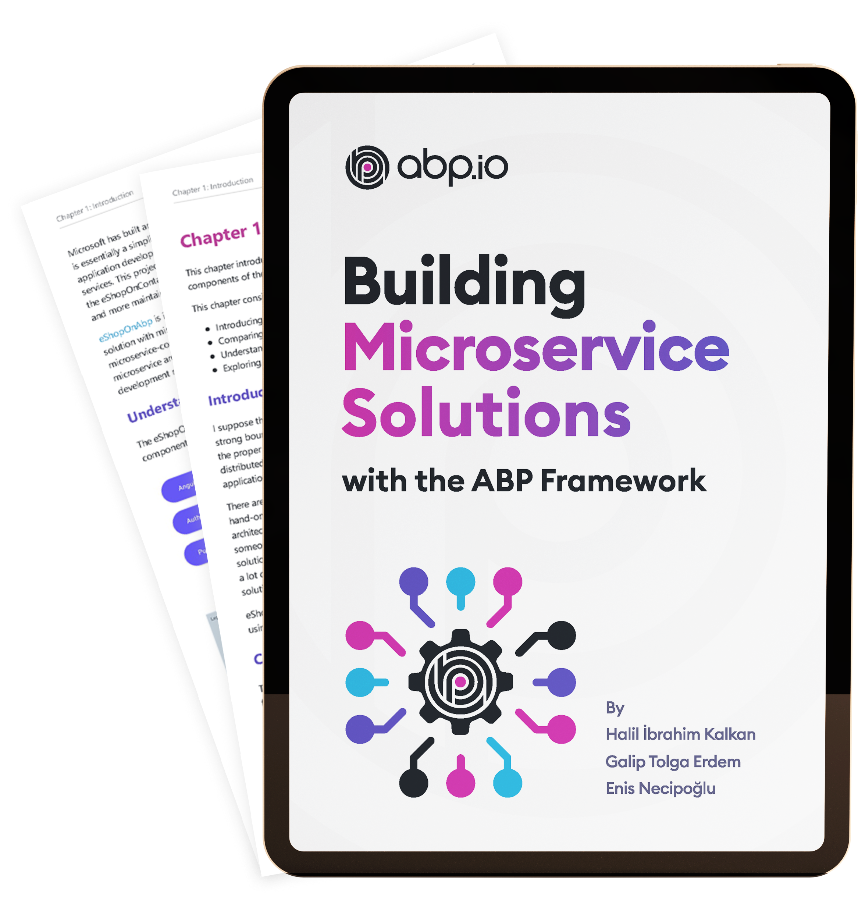
eShopOnAbp project updates
Keycloak Integration for authentication
CMS Kit integration (product rating & comments)
Ongoing e-book process…

Slide 20
TODO
Content

Slide 21
TODO
Content

Slide 22
TODO
Content

Slide 23
TODO
Content

Slide 24
TODO
Content

Slide 25
TODO
Content

